Slide 1
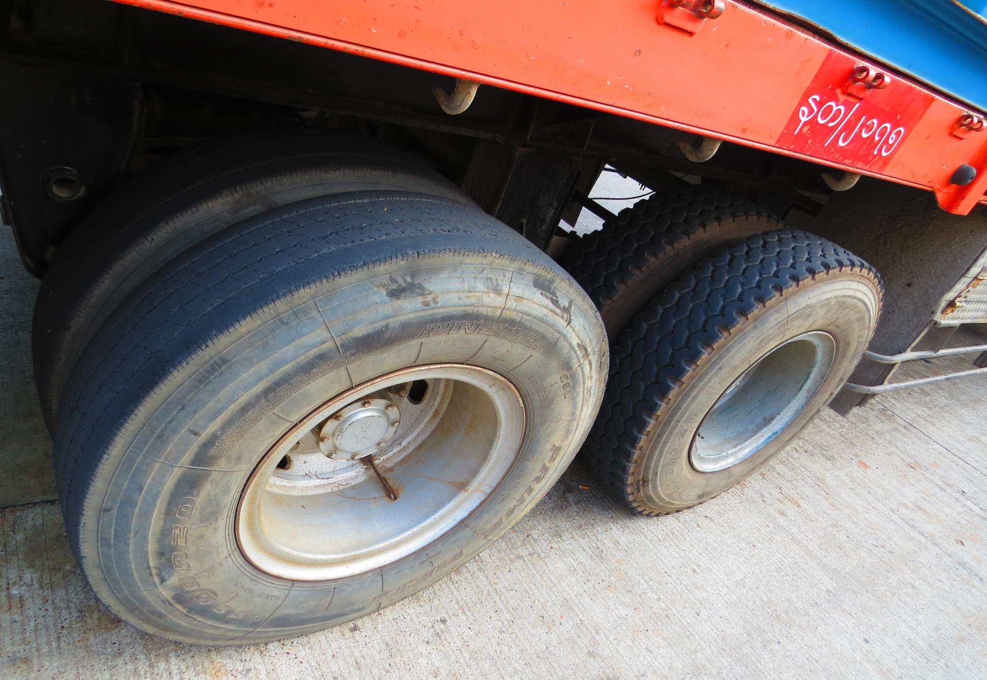
A Look at Logistics and Tire Quality on Container Hauling Vehicles in Yangon Myanmar 2014

Slide 2
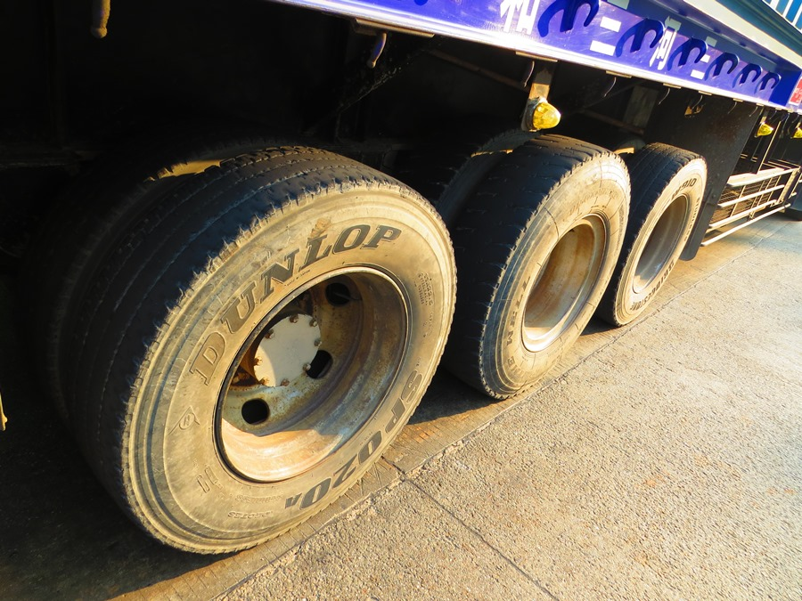

Slide 3
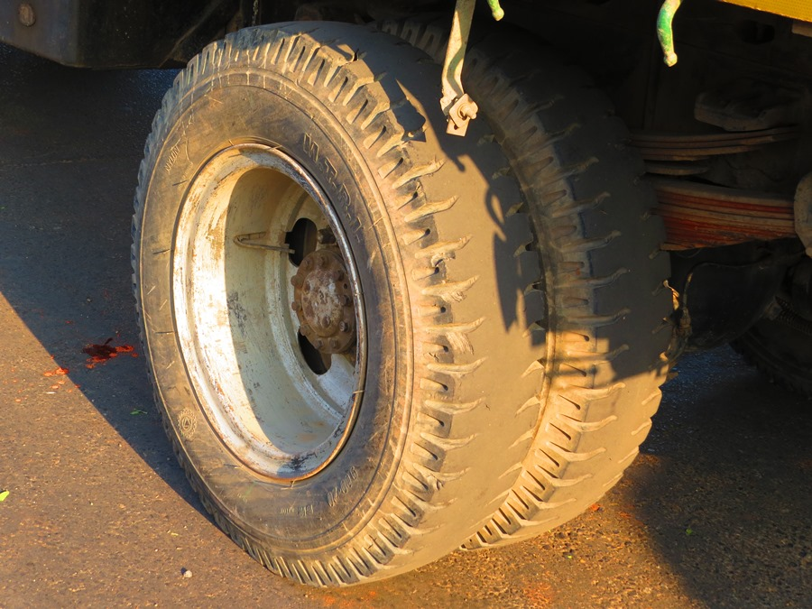

Slide 4
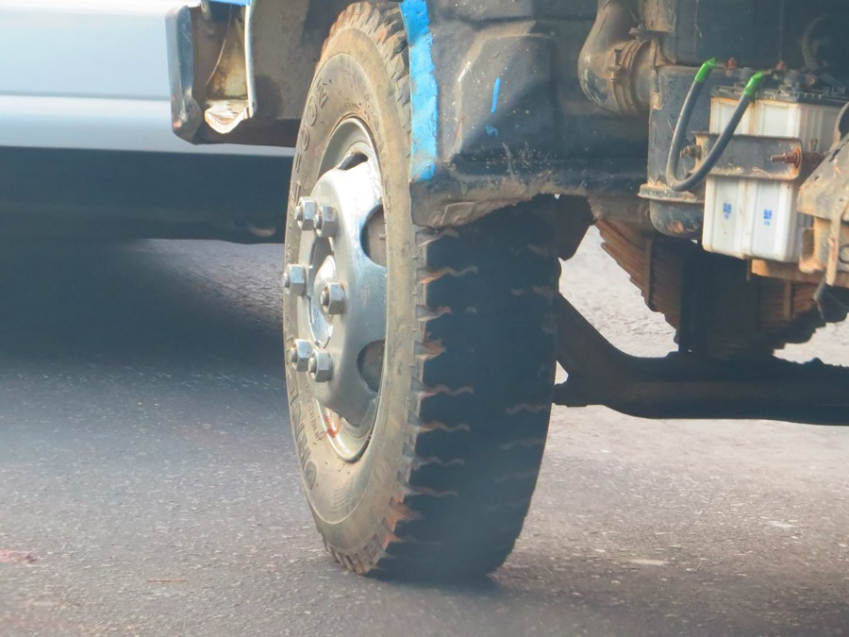

Slide 5
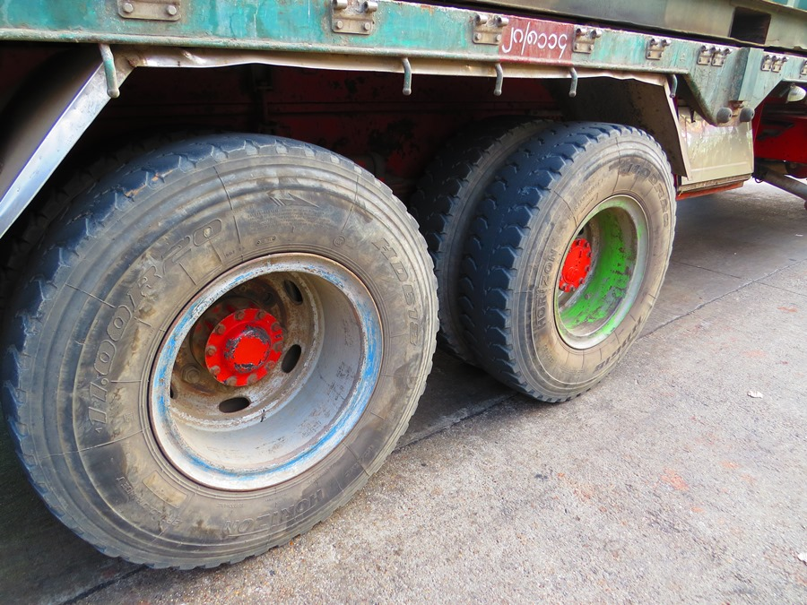

Slide 6
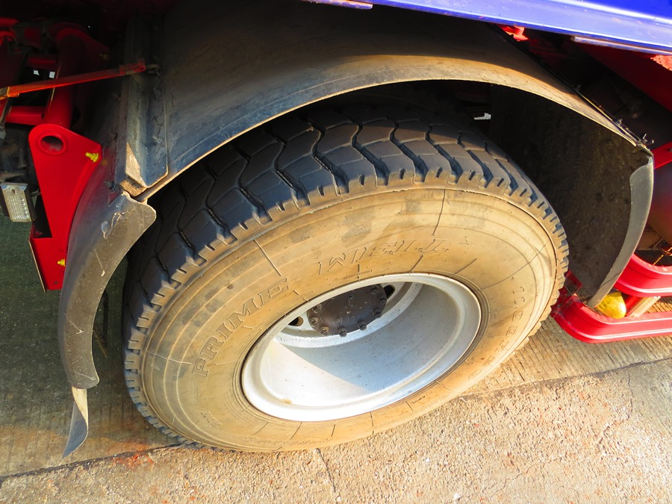

Slide 7
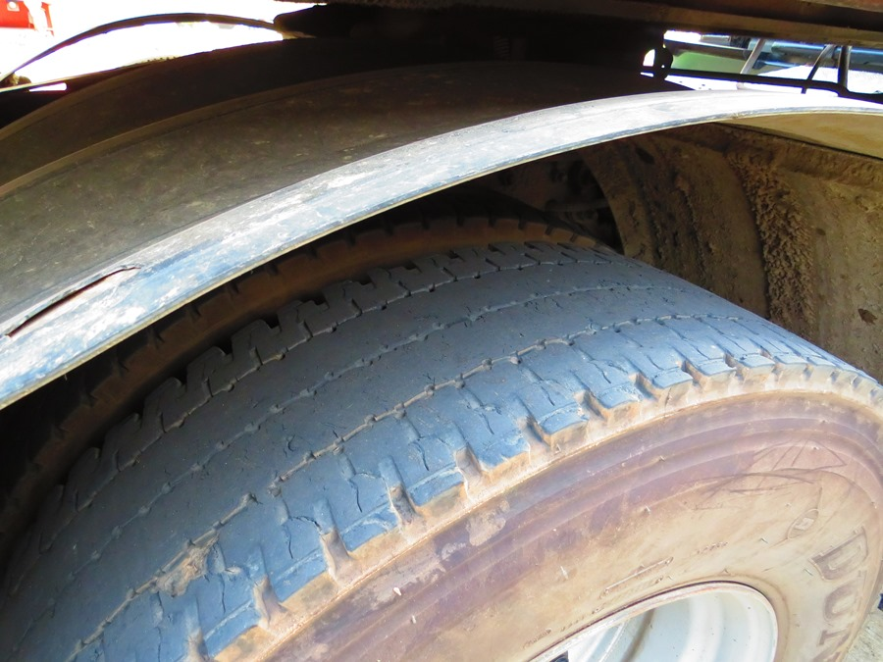

Slide 8


Slide 9
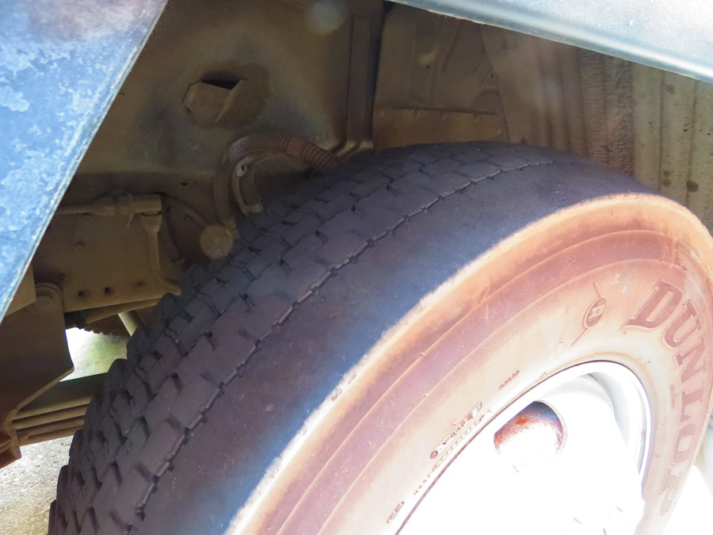

Slide 10
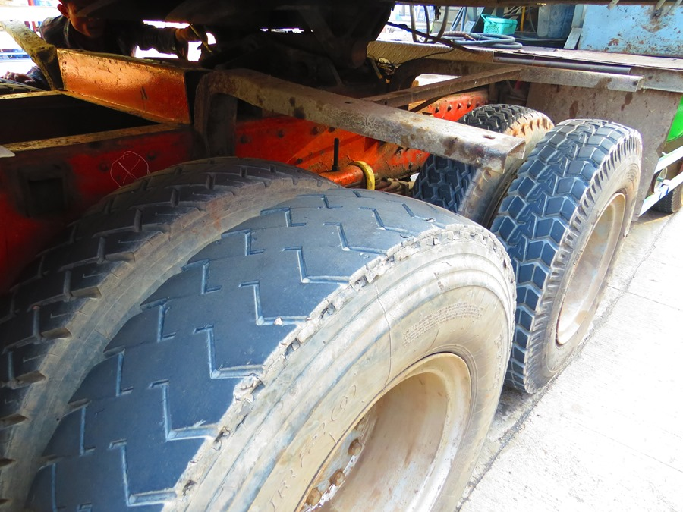

Slide 11
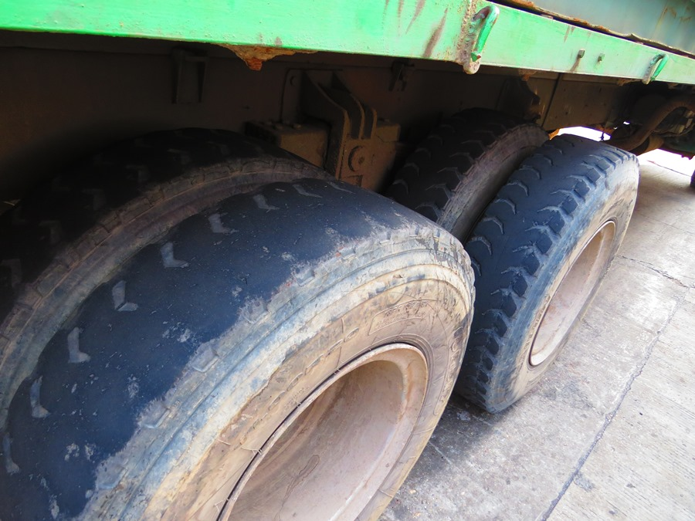

Slide 12
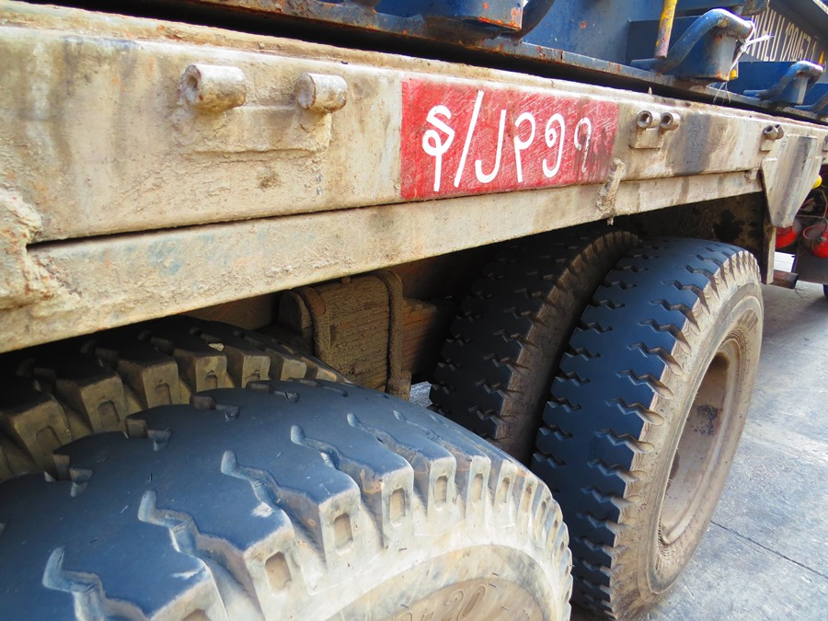

Slide 13
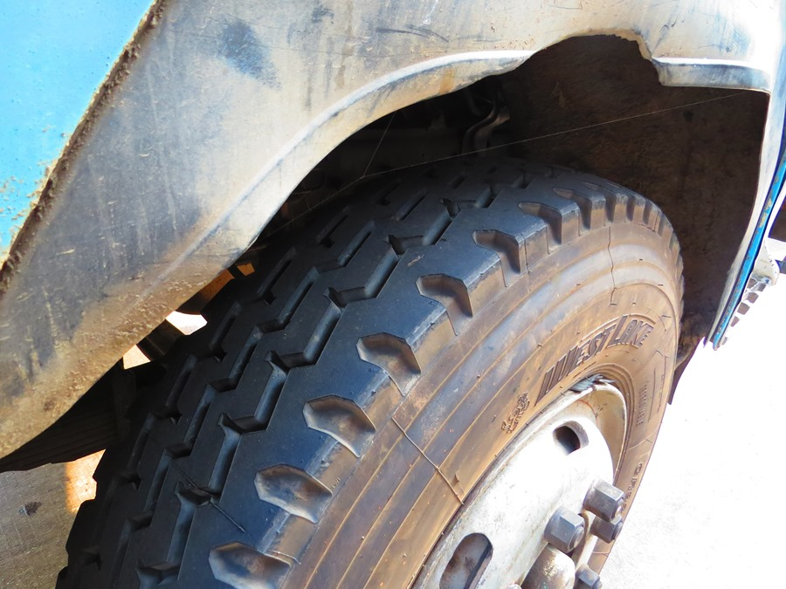

Slide 14
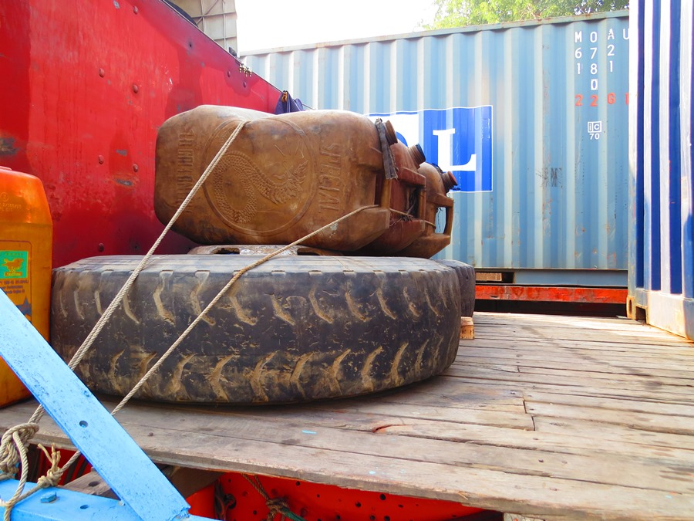

Slide 15
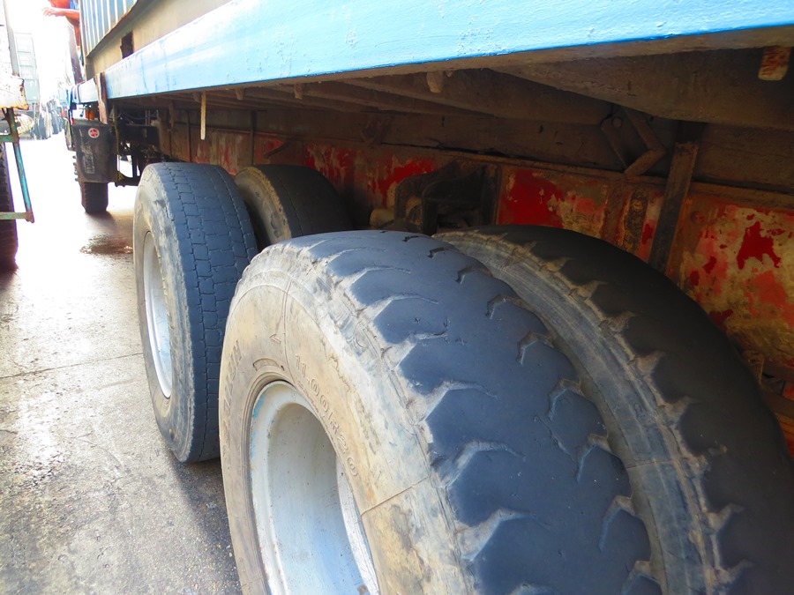

Slide 16
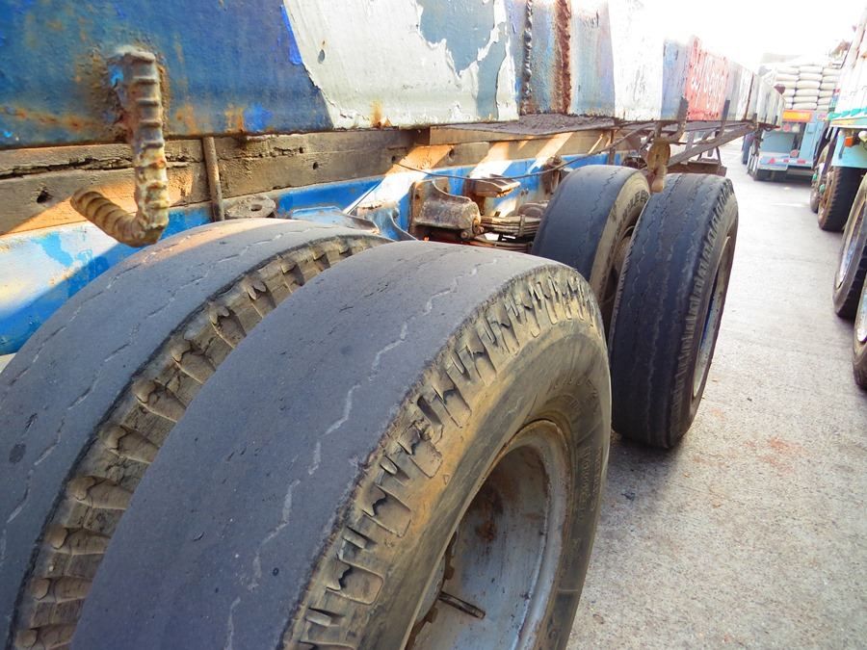

Slide 17
PowerPoint Created Feb 2014 after a trip to Yangon specifically for logistics and supply chain information gathering.
If you have any questions or comments I can be reached through:
David DuByne
ddubyne {at] oilseedcrops.org

