Slide 1
Developing new Special Economic Zones (SEZ’s) in Myanmar to Attract
Overseas Investors

Slide 2
Contents
About Myanmar
Company Background
Industrial Analysis
SWOT Analysis
Vision, Mission and Goals
Action Plan
Execution and Management
Marketing Plan
Technical Aspect or Buying and Selling Process
Financial Plan
Risk Analysis

Slide 3

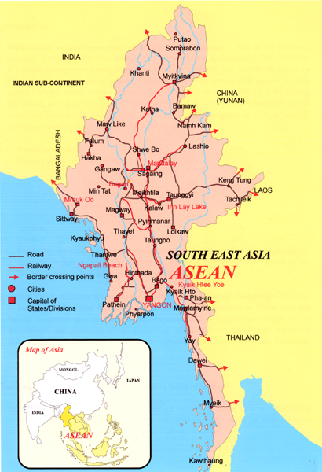
UNION OF MYANMAR
Myanmar is the largest country on mainland South-East Asia with a total land area of 676,577 sq.km
Total coastline is 2,832 km.
Shares total international borders of 5,858 km
Bangladesh and India on the north-west,
China on the north-east and;
Laos and Thailand on the south-east.
Dynamic crossroad linking South East Asia, Western China (Yunnan) and the Indian sub-continent
Economic gateway to a potential vast market of over two billion consumers as well as sub-regional economic nodal link.
Population around 56 Million

Slide 4
Industrial Analysis in Myanmar
Yangon Division (East Yangon) – South Dagon Industrial Zone(1)
South Dagon Industrial Zone (2)
South Dagon Industrial Zone (3)
East Dagon Industrial Zone
Dagon Seikkan Industrial Zone
North Oakkalapa Industrial Zone
South Oakkalapa Industrial Zone
Shwe Pauk Kan Industrial Zone
Tharketa Industrial Zone
(North Yangon) – Hlaing Thar Yar Industrial City
Shwe Pyi Thar Industrial Zone
Yangon Industrial Zone
Shwe Linban Industrial Zone
Mingalardon Industrial Park

Slide 5
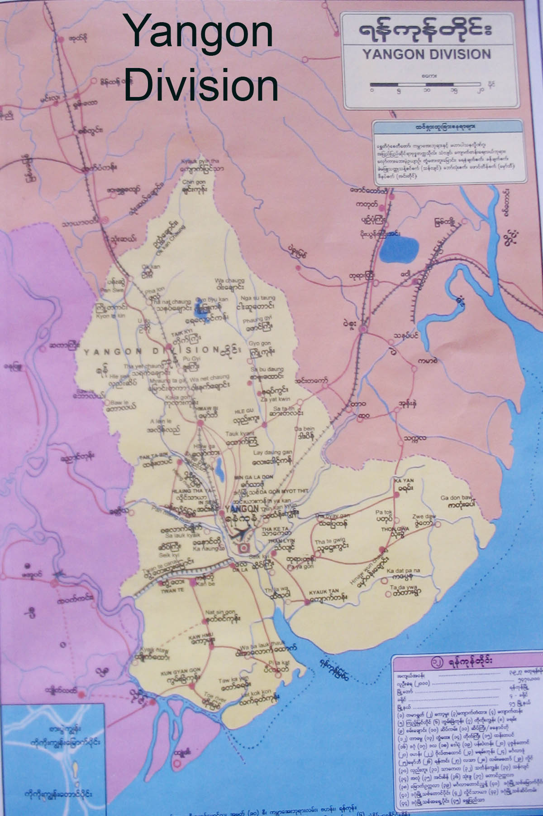
Some of existing Industrial Zones around Yangon
Shwe pyi thar industrial Zone
Hlaing Thayar industrial Zone
East Dagon industrial Zone
South Dagon industrial Zone
Dagon Seikkan industrial Zone
Thilawar (Thanlyin) industrial Zone

Slide 6
Industrial Analysis in Myanmar
Mandalay Division - Industrial Zone (1)
Industrial Zone (2)
Myin Chan Industrial Zone
Meikhtila Industrial Zone
Ayarwaddy Division – Pathein Industrial Zone
Myaung Mya Industrial Zone
Hinthada Industrial Zone
Sagaing Division - Monywa Industrial Zone
Tanintharyi Division – Myeik Industrial Zone
Magwe Division - Yenangyaung Industrial Zone
Pakokku Industrial Zone
Shan State - Aye Thar Yar Industrial Zone (Taunggyi)

Slide 7
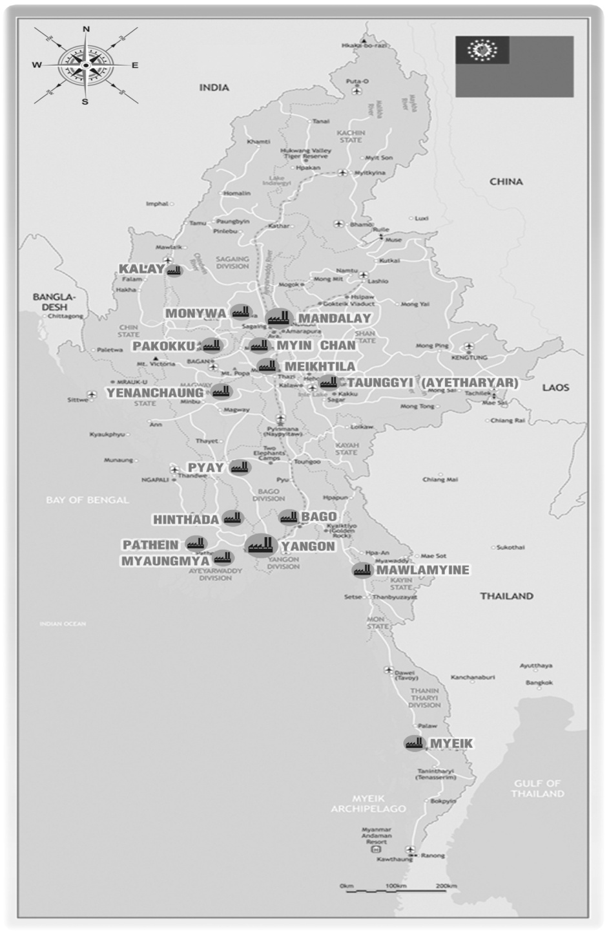
INDUSTRIAL ZONES IN MYANMAR

Slide 8
S W O T
Analysis
Strength of Thanlyin – Kyauktan
Special Economic Zone

Slide 9
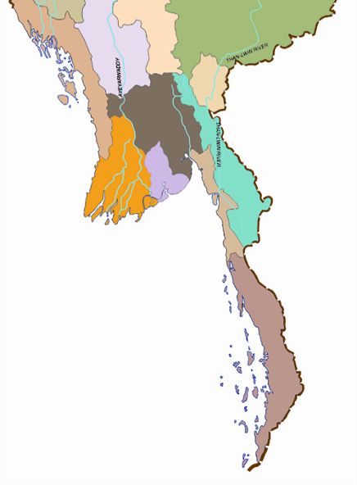

Myanmar Deep Sea Port
Ports of Myanmar
SITTWE
Myanmar has a total of nine ports catering mainly for its seaborne and coastal trade
spreading over the whole coastline
Yangon is the Major Port city of Myanmar
KYAUKPYU
THANDWE
YANGON
PATHEIN
MAWLAMYINE
DAWEI
MYEIK
KAWTHOUNG
Notes:
Myanmar Deep Sea Port

Slide 10
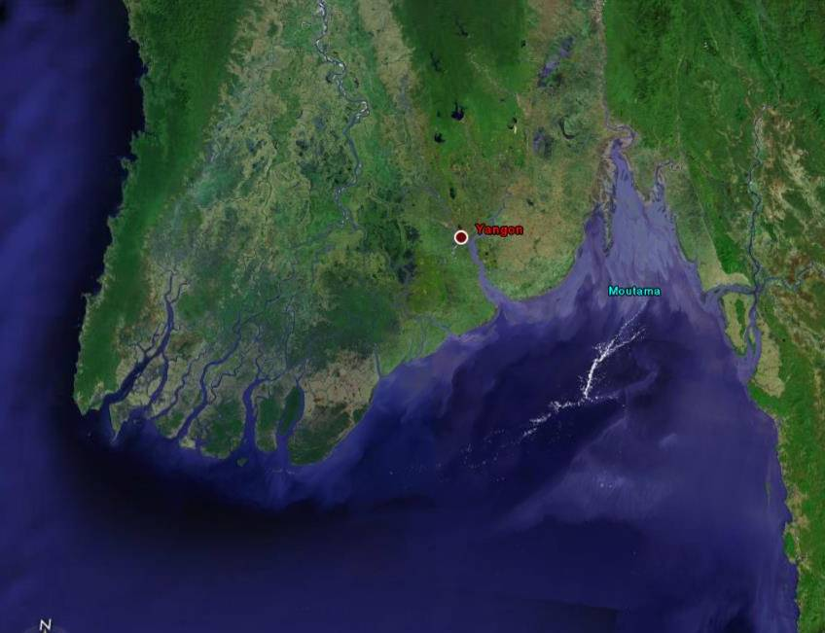
Yangon Sea Access Channel

Slide 11
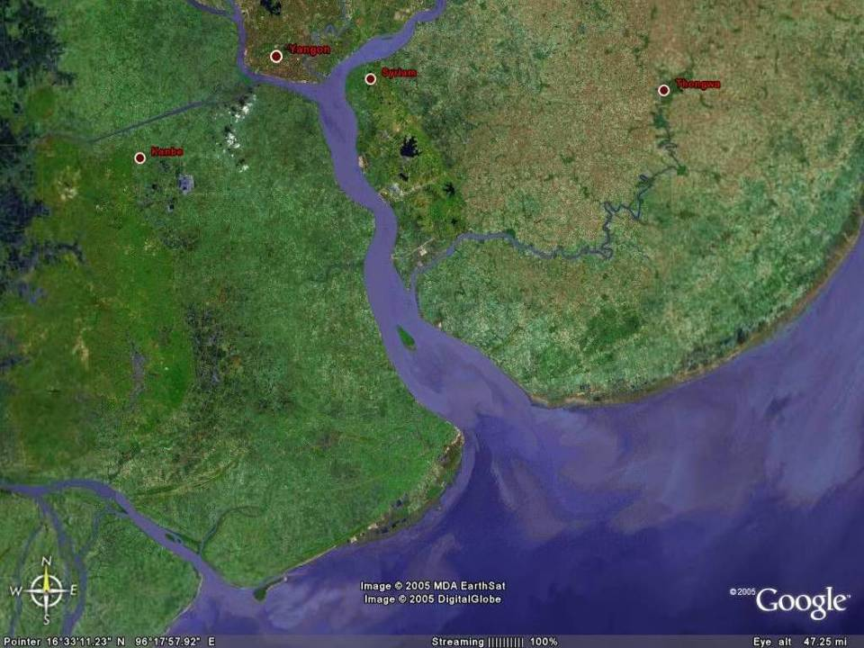

Slide 12
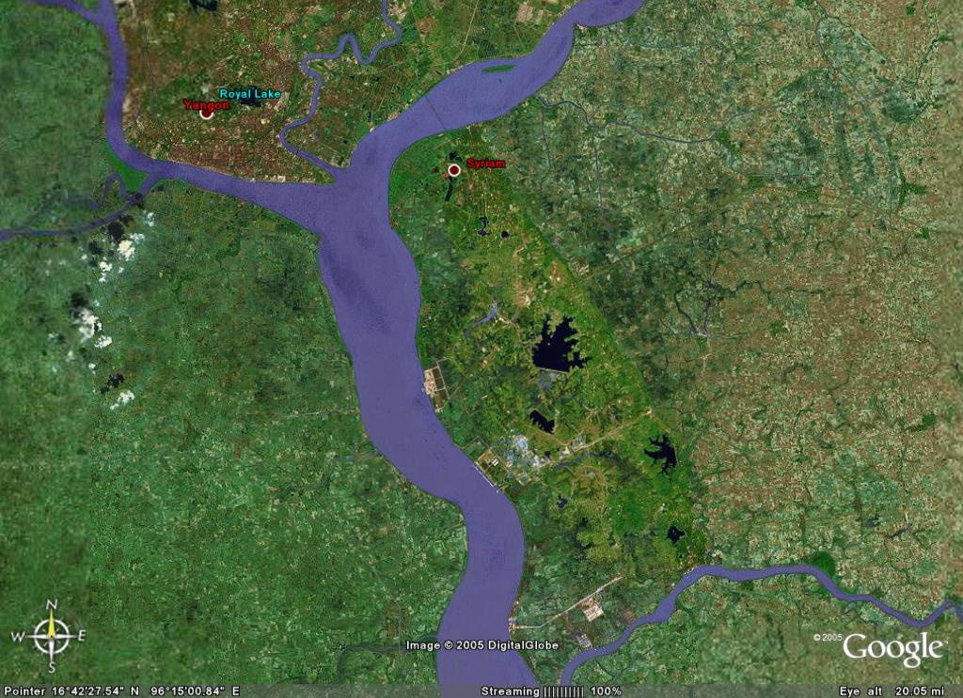
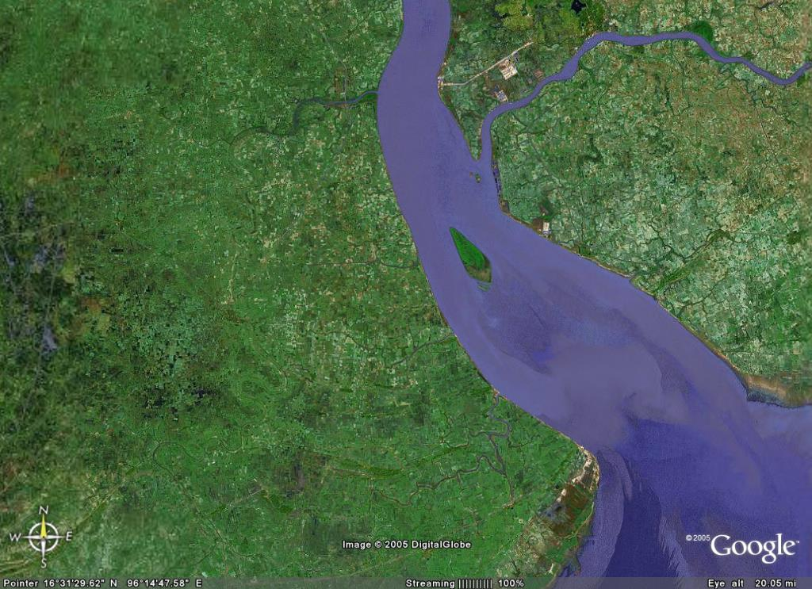
Yangon River

Slide 13
Yangon Port
  15000 DWT
  LOA 167 m
  Draft 9 m
Thilawa Port
  20000 DWT
  LOA 200 m
  (for cruise vessel up to 268 m)
  Draft 9 m
Yangon River Estuary
YANGON
RIVER
Pazundaung
Creek
YANGON
BAGO RIVER
BRIDGE
THANLYAN
INNERBAR
Liffey
SECONDARY CHANNEL
Chokey pt.
N
Main
Channel
d Silva Pt.
THILAWA PORT AREA
Kyauktan Creek
There are two restricted bars
along the approached channel.
THANTE
-10
EASTEN
GROVE
FLATS
ELEPHANT pt.
-5
Inner Bar (near Yangon Port at Monkey Point)
-3
Outer Bar (at the mouth of the River)
OUTER BAR

Slide 14
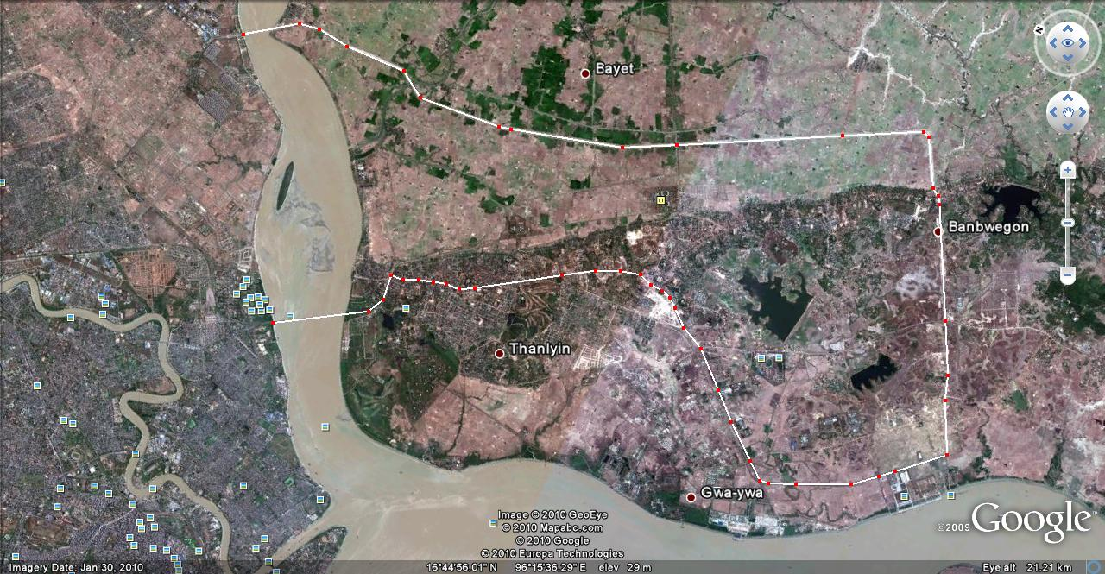
Routes to Thilawa – Thanlyin Kyauktan SEZ
Dagon Seikkan Industrial Zone
24 km
17 km
Thanlyin- Kyauktan Industrial Zone & SEZ
MITT

Slide 15
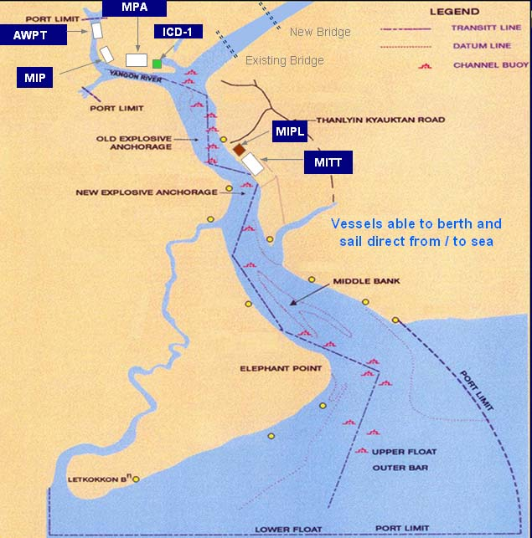
Yangon Port and Terminal Locations

Slide 16
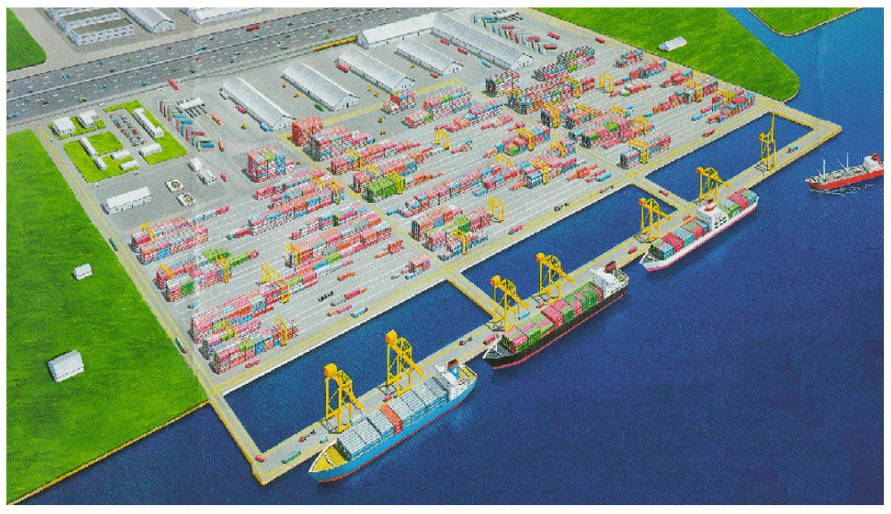
Layout Plan of Myanmar International Terminals Thilawa

Slide 17
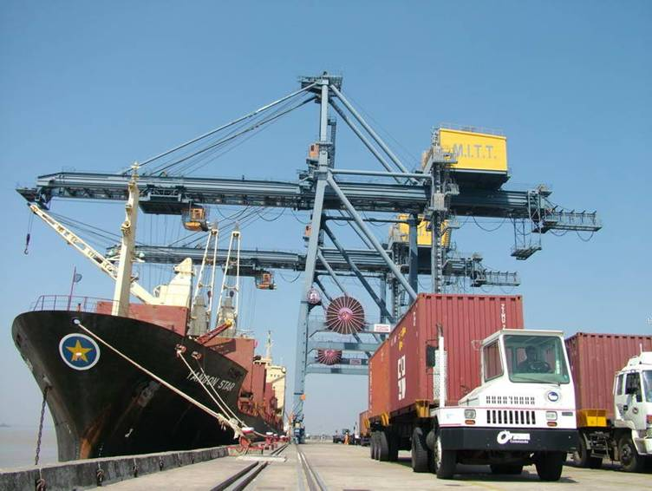
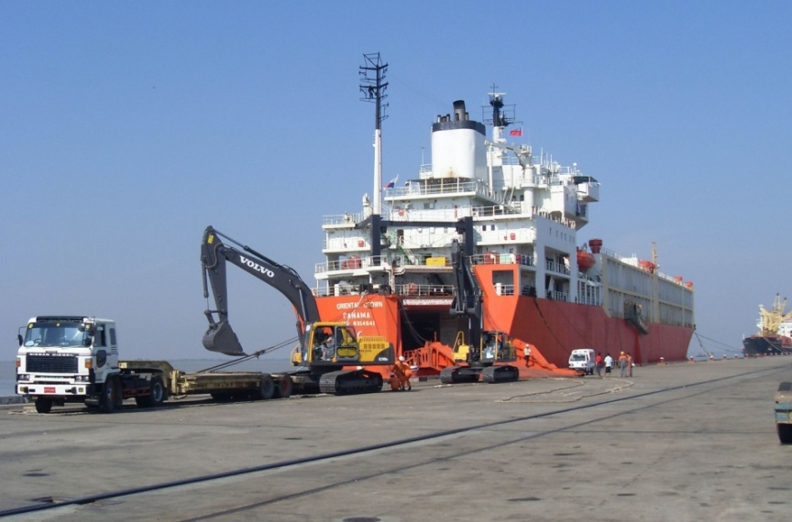
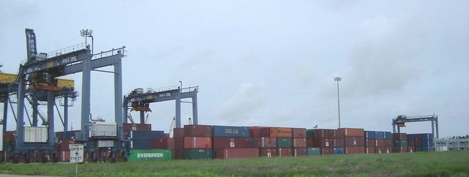
Facilities at Myanmar International Terminals Thilawa
Container Vessel
Ro – Ro Vessel
Total Area (ha) : 75
Total Berth Length (m) : 1,000
Depth Alongside (m) : 10
Container Cranes : 2
RTG Yard Cranes : 3
Reachstackers : 2
Empty Handler / FLTs : 3
Reefer Plugs : 108
CFS / Warehouse (Sq.m) : 20,000
Full Container Yard - FCY

Slide 18
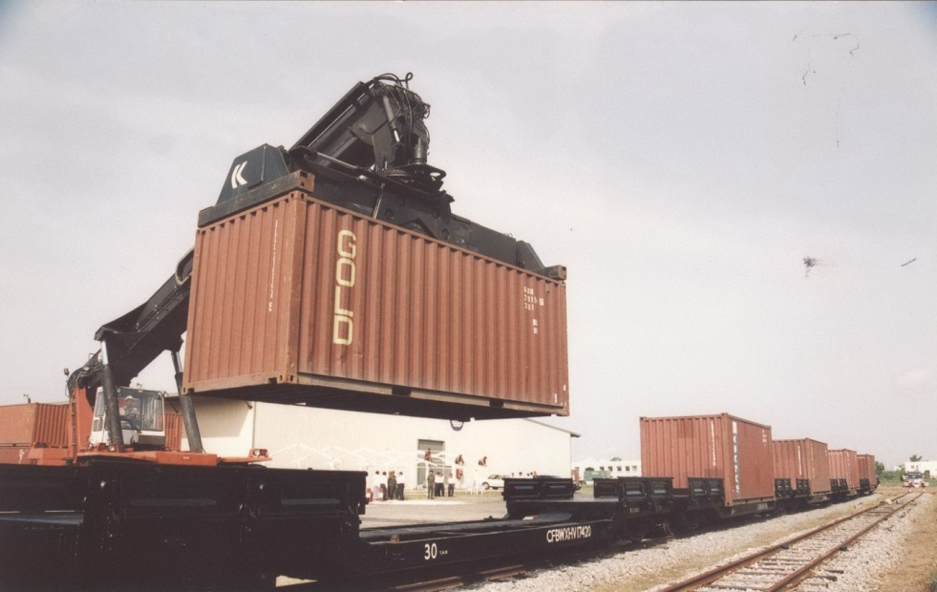
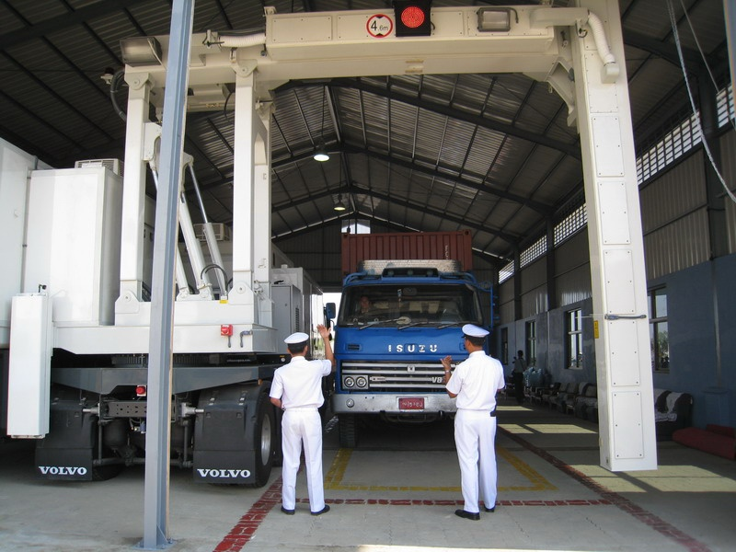
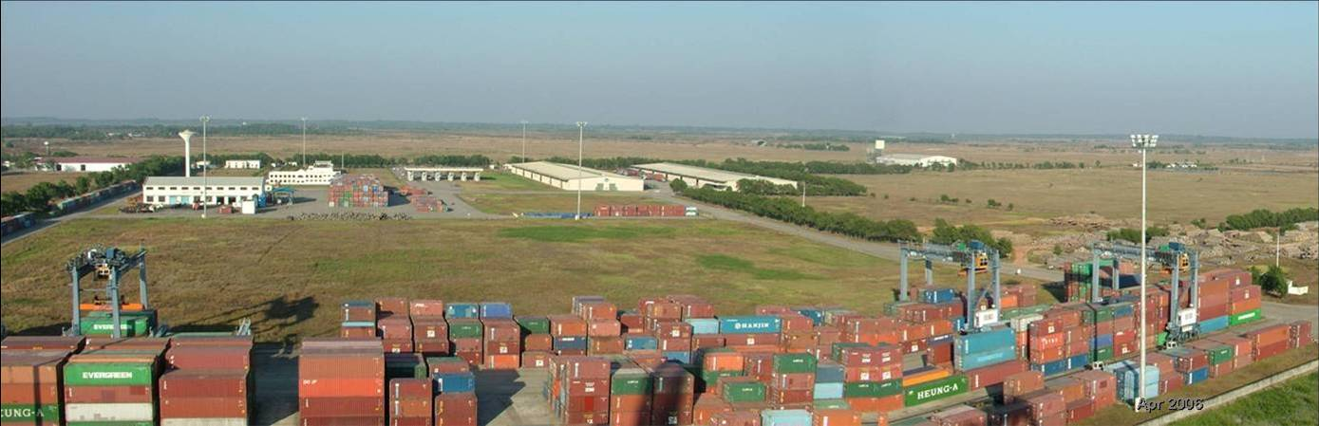
Facilities at Myanmar International Terminals Thilawa
Rail Facility
X Ray Scanner
Thanlyin- Kyauktan Industrial Zone & SEZ

Slide 19
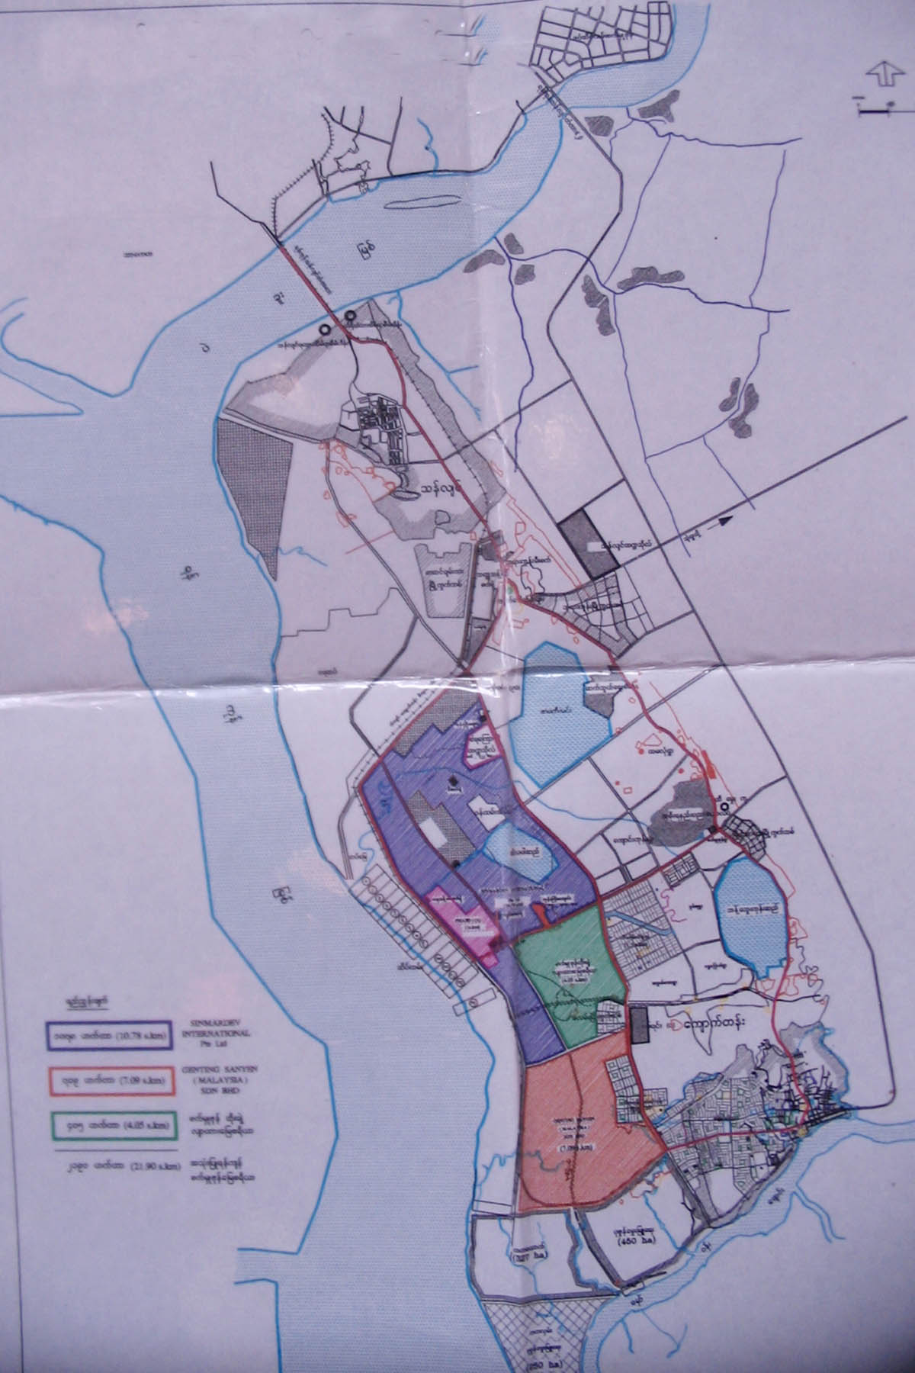
Thanlyin – Kyauktan Special
Economic Zone Location
SEZ Proposed by Singapore
SEZ Proposed by China
MITT (Deep Sea Port Thilawar )
)
SEZ Proposed by Japan
SEZ Proposed by Malaysia
500 Companies has signed
MOU with our company.

Slide 20
Strengths
1 Km from Myanmar International Terminal Thilawa (Deep Sea Port)
25 Km from Yangon International Airport
30 Km from Business Areas of Central Yangon
24 Km from Supporting Industrial Zone (East Dagon)
5 Km from No. 5 Highway
Attractive Tax Exemptions

Slide 21
Type of Investment | Incentive
Manufacturing Sector | First (5) years (100%) income tax exemption Second (5) years (50%) income tax exemption @ 15%
High Technology Sector | First (8) years (100%) income tax exemption @ 15%
Agriculture / Forests Products / Husbandry | From getting profit (100%) income tax exemption for (5) years Next (5) years (50%) income tax exemption @ 15%
Banking & Finance | From getting profit (1) Year (100%) income tax exemption Next (2) years (50%) income tax exemption @ 15%

Slide 22
Exemption
Free trade tax on Export commodities
8% trade tax only on Electricity sales.
Custom duty free on import commodities using in zone.
After payment made specific land lease for (50) years, another (25) years can be lease.
Lease can transferable / lease to another person again / Allow to pawn.
Domestic Banking / Foreign Banking allow in zone.
Foreign Exchange Freely exchange, transfer using in zone.

Slide 23
Strengths
Fiber Optic Cable for internet and networking
100 MW Electricity Supply 33KV-11KV-0.4KV
Accessible to All kind of Mobile and Wired Telecommunation
Easy to get Tube Water Supply
Easy access of Human Resources – about 1 Million working population within 5 Km
Easy access of experienced Pensioners
Educational Resources – East Yangon University, East Yangon Science and Technology Institute, Yangon Co-operative College, Government Technical College within 5 Km.
Abundant Extractable Natural Resources

Slide 24
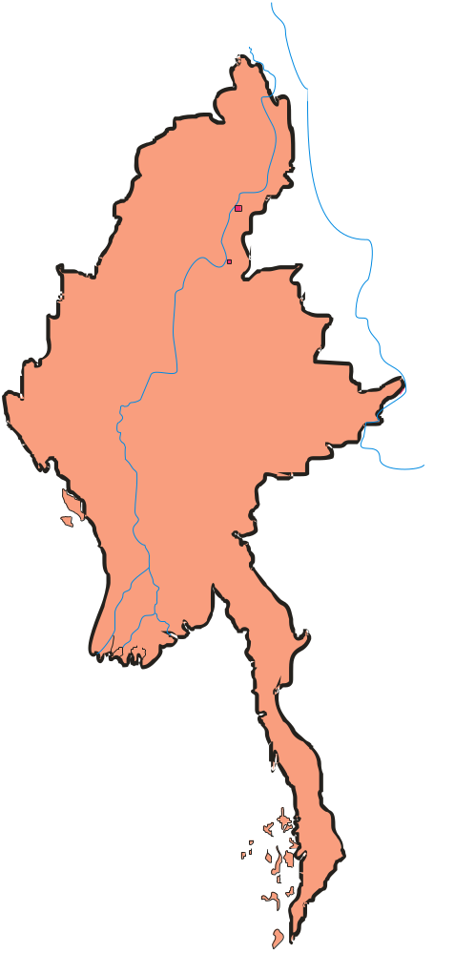
Myanmar’s Potential Markets
China
1,315 Mil
China
$1,410 Bln
India
1,103 Mil
India
$591 Bln
Bangladesh
141 Mil
Bangladesh
$56 Bil
54 Million
Laos 6 Mil
$58 Bln
Laos $2 Bil
Thailand
$143 Bil
Thailand
64 Mil
Total People
2,683 Million
Total GDP
US$2,252 Billion
Less Than 500 Miles Away

Slide 25
Weakness
SEZ law still under processing
Unstable Electricity Supply
Lack of Transparency between Government and )Private Sectors
Lack of Skill Labour
Foreign Exchange Monetary Policy
Restrictive Government Procedures
Centralized Management Mechanism

Slide 26
Opportunities
Strategic Geographical Location
Land bridge between Middle East and South East Asia
Between Two Biggest Population Countries

Slide 27
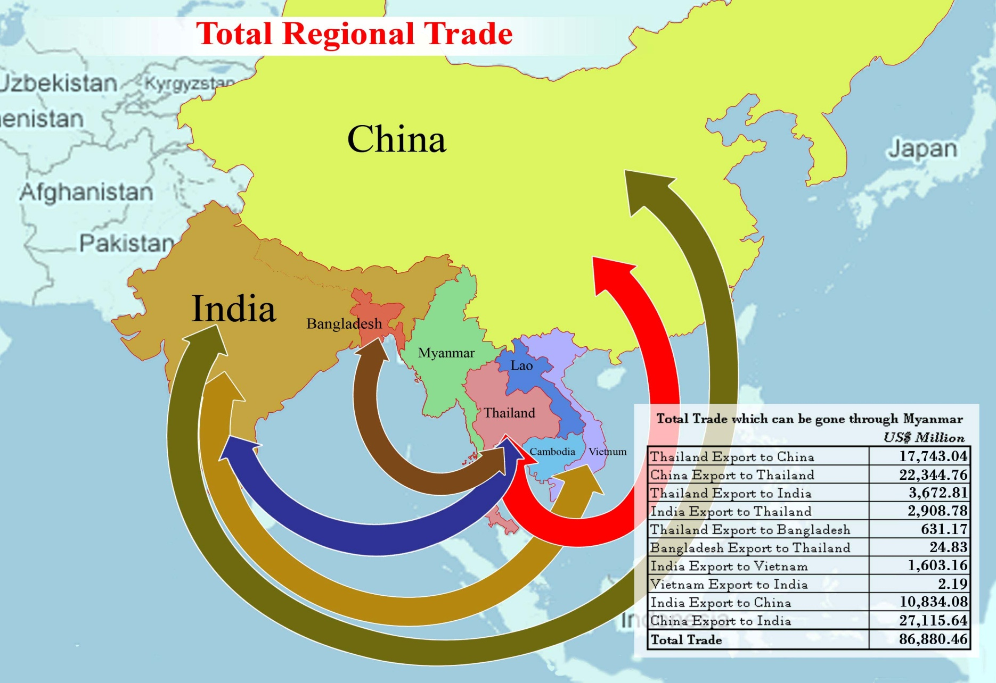

Slide 28
Threats
High Competition with Neighbouring countries
US and EU Sanction
AFTA in 2015
Skill Labour Migration due to high attractiveness by neighbouring countries
Goods Dumping by neighbouring countries

Slide 29
Mission
(1) To contribute in making sound economic foundation of Myanmar by attracting and accommodating legitimate Myanmar and foreign investors
(2) To prepare investors-friendly environment by closely coordinating with the Government of Myanmar
(3) To create job opportunities for Myanmar young generation
(4) To develop and operate our special economic zone in environment-friendly ways
(5) To make efforts in upgrading technical skills of Myanmar workers
(6) To always pay attention to neighbor communities to develop and keep harmonious relationship
(7) To play an integral role for maximizing the well-being and prosperity of Myanmar people

Slide 30
Action Plan
To design a Master Plan and summit to Myanmar Investment Commission (MIC)
To get approval from Myanmar Industry Development Committee (MIDC) and concerned Ministries
To make contracts with Proposed Customers
To set up Once Start One Stop (OSOS) services for Investors
To enforce environmental protection plan

Slide 31
Risk Analysis
Factors that can obstruct the project are as follows:
Political turmoil such as demonstration and military coup which are uncontrollable factors
World economy impact, specifically recession
US and EU Sanction
Unchanged Monetary Policy

Slide 32

Action Plan to set up SEZ development
1) To enact SEZ law in Myanmar
2) To set up public and private partnership (PPP)
3) To review and amend industrial and trade regulation
4) To study regional and international market situation and find out the appropriate incentive for the investors
5) To cooperate with Government for Electricity and Infrastructure development
6) To eliminate all barriers

