Slide 1

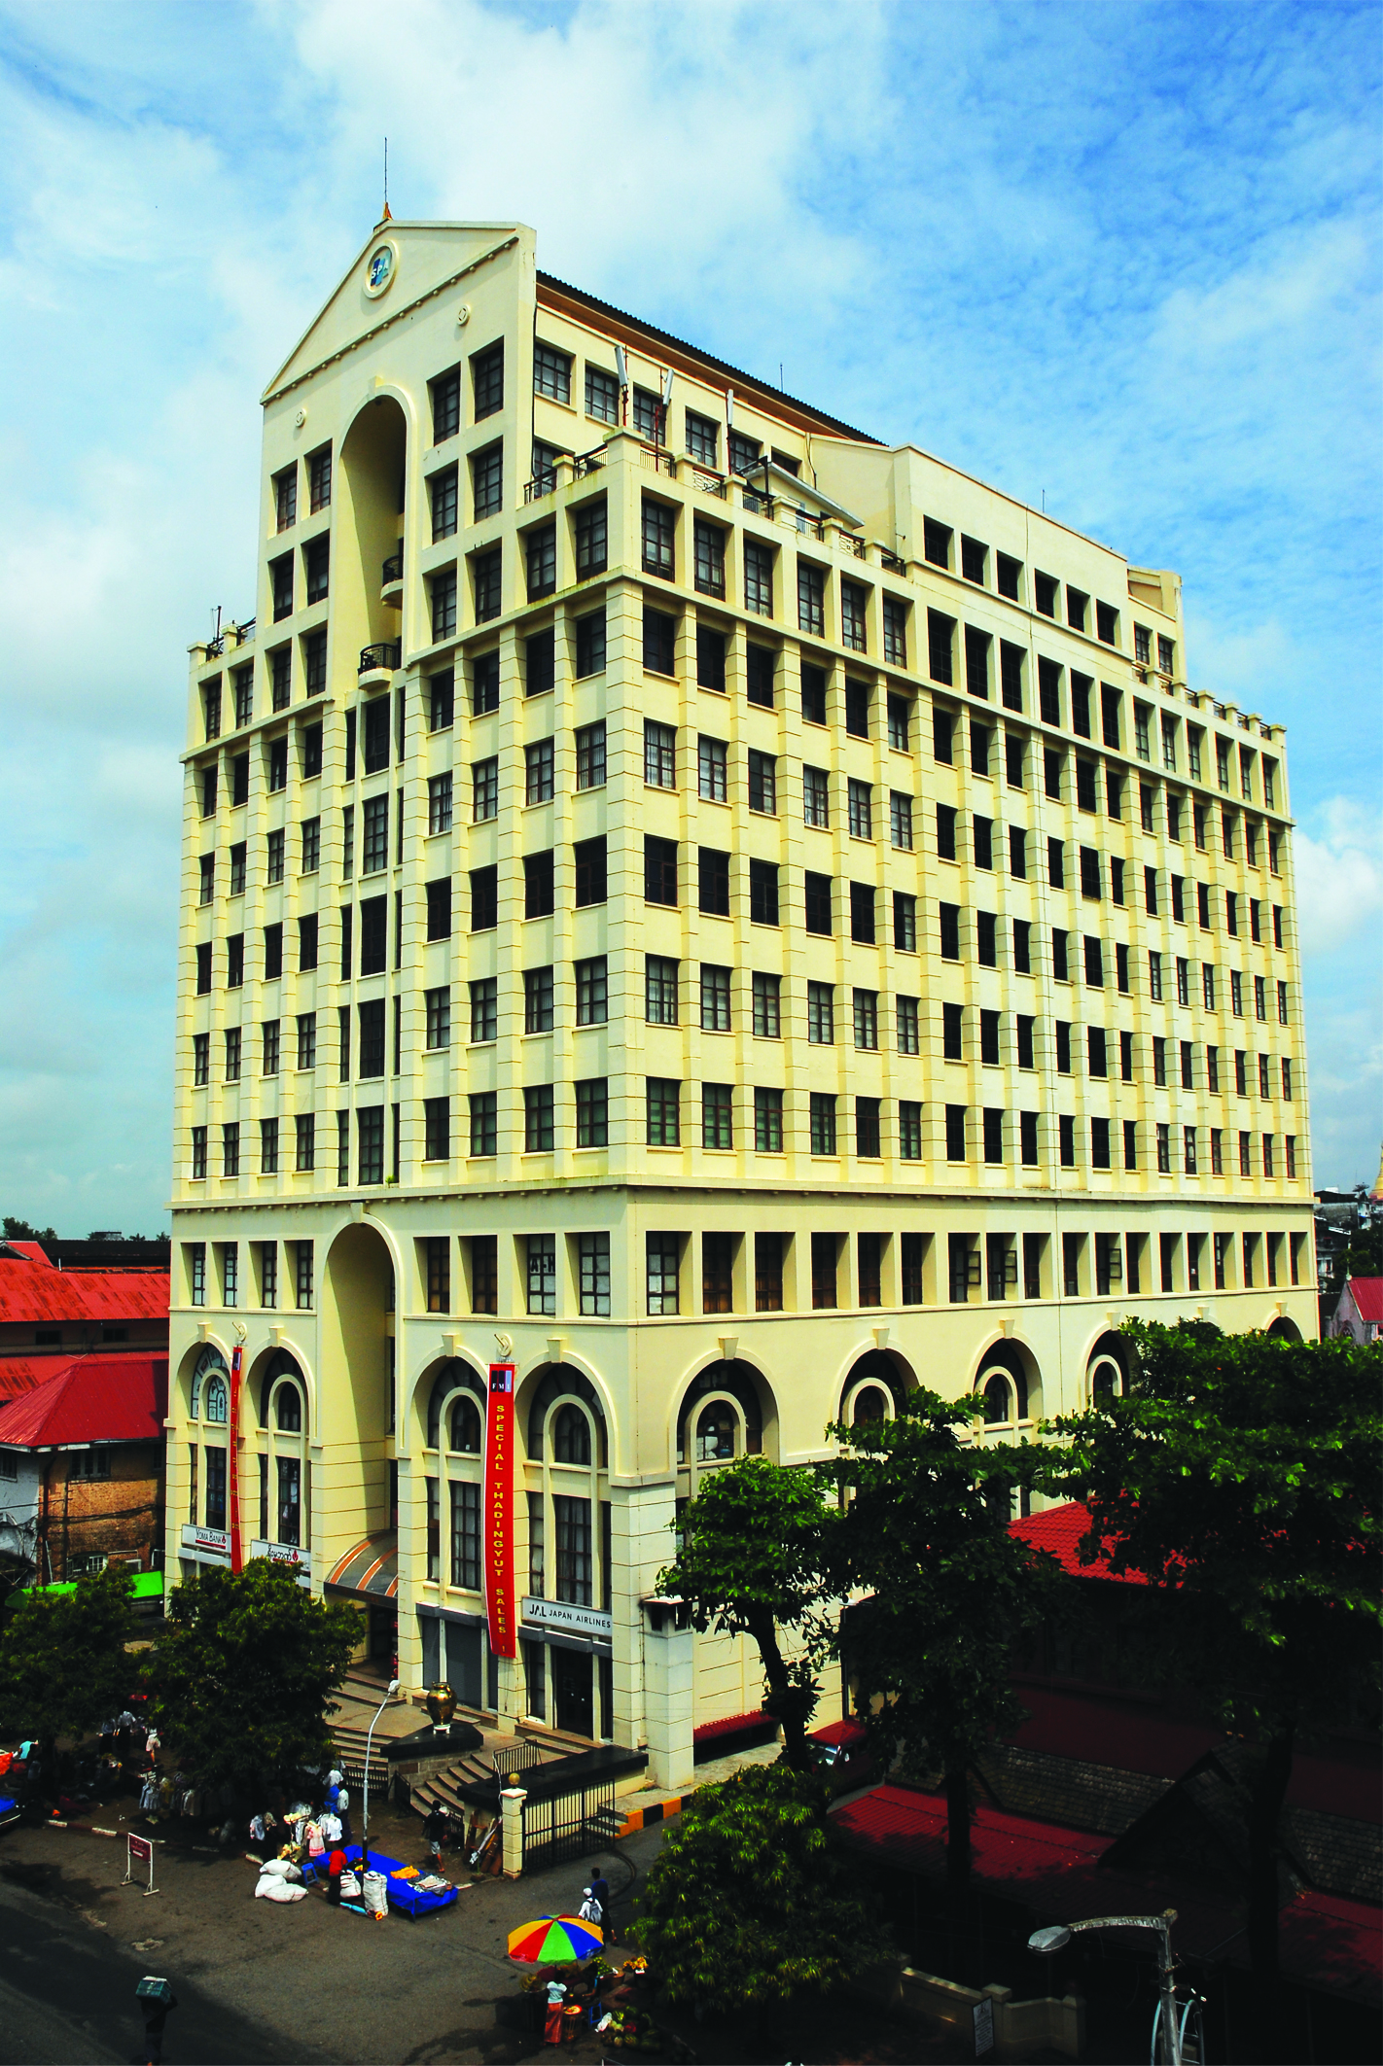
S
P
A
Serge Pun & Associates

Slide 2


Contents
Company’s Profile
Sectors
Mission And Seven Focus
Real Estate
    FMI City
    Pun Hlaing Goft & Country Club
    Thanlyin Star City
S.W.O.T Analysis
Our Suggestions

Slide 3
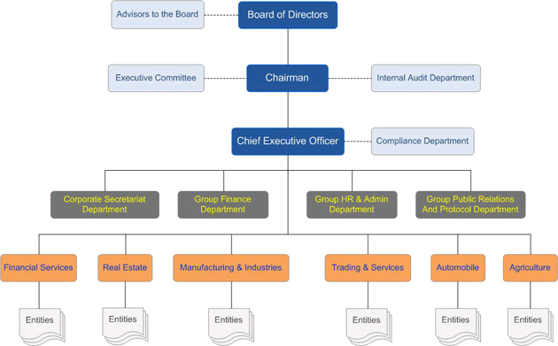
Corporate Structure

Slide 4
SPA has focused on six spheres of business
Financial Services
Real Estate Developments
Manufacturing & Value-Added Industries
Leisure and Service Related Businesses
Trading and Wholesale Distribution
Management and Consultancy Services

Slide 5
FMI: First Myanmar Investment
One of the earliest public company
Established in 1992
Publicly owned investment holding company
Pursuing six different spheres of businesses

Slide 6


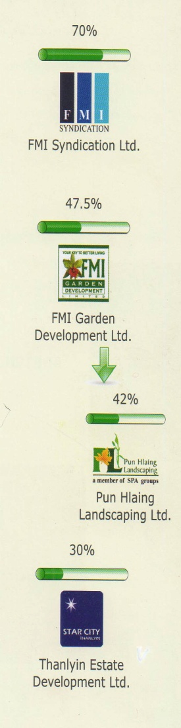

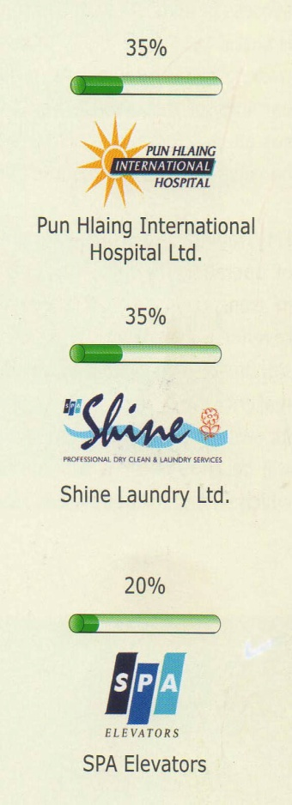

FIRST INVESTMENTS OVERVIEW
Financial Services
Automobile
Real Estate
Agriculture
MFG &Industries
Services

Slide 7
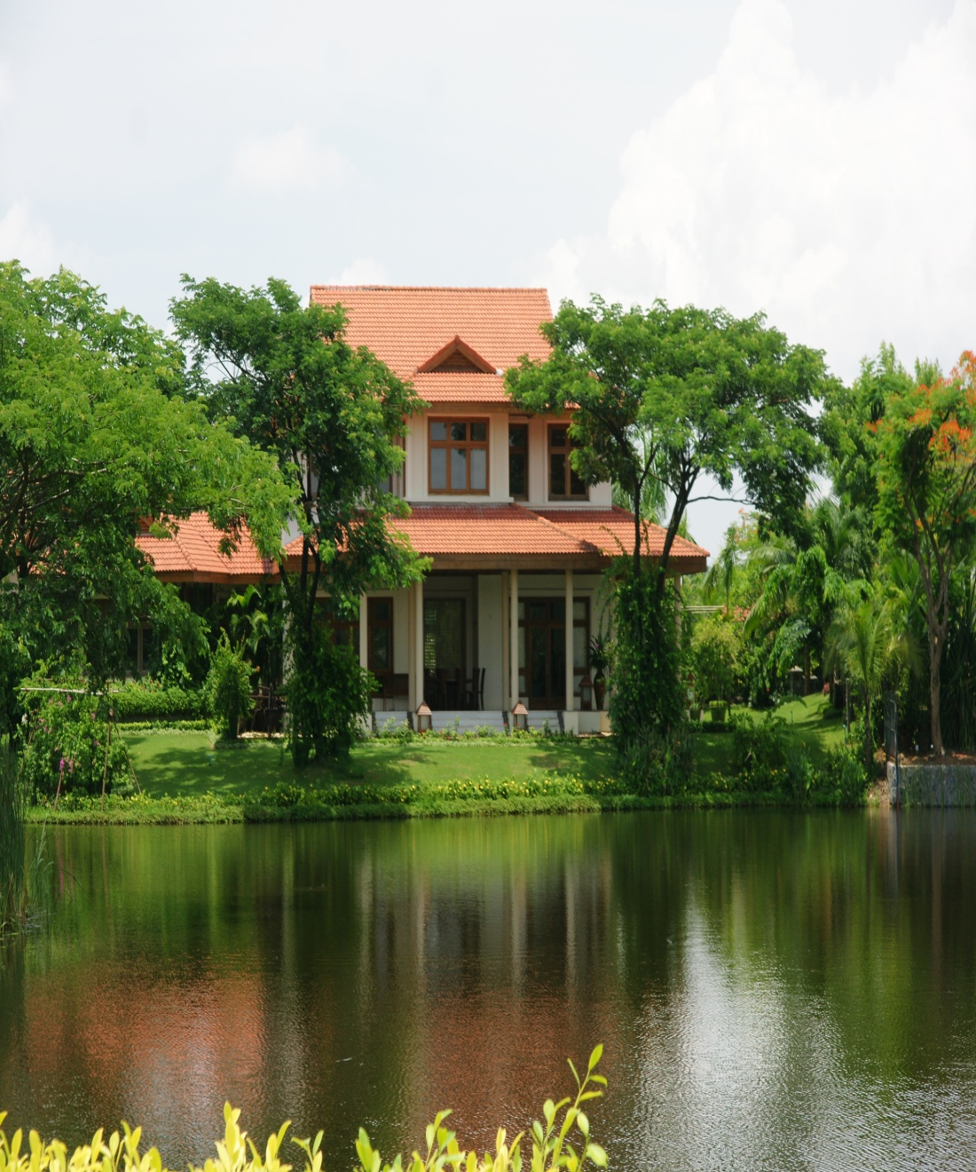
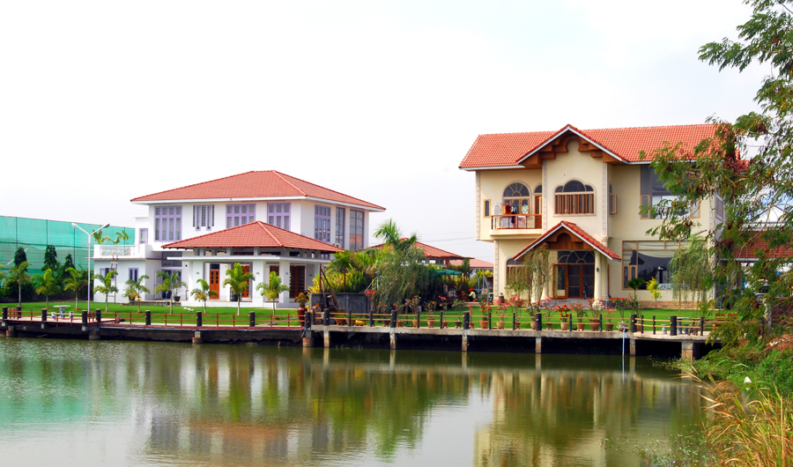
Three Housing Projects Done By SPA Company are
FMI City ( about 650 acres )
Pun Hlaing Golf Estate ( about 637 acres )
Thanlyin Star City ( about 400 acres )

Slide 8
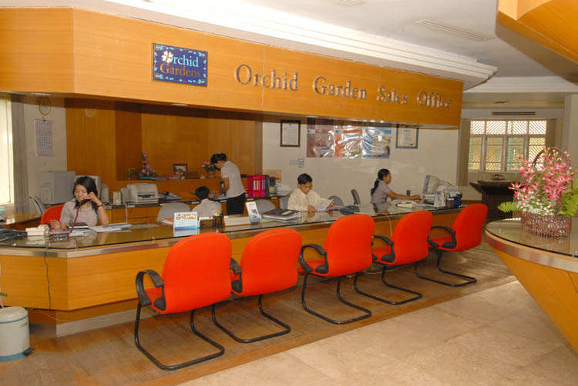
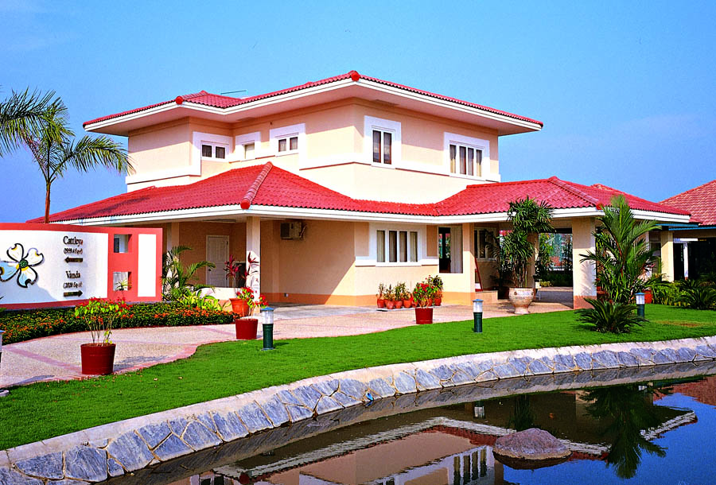
FMI City and Garden

Slide 9
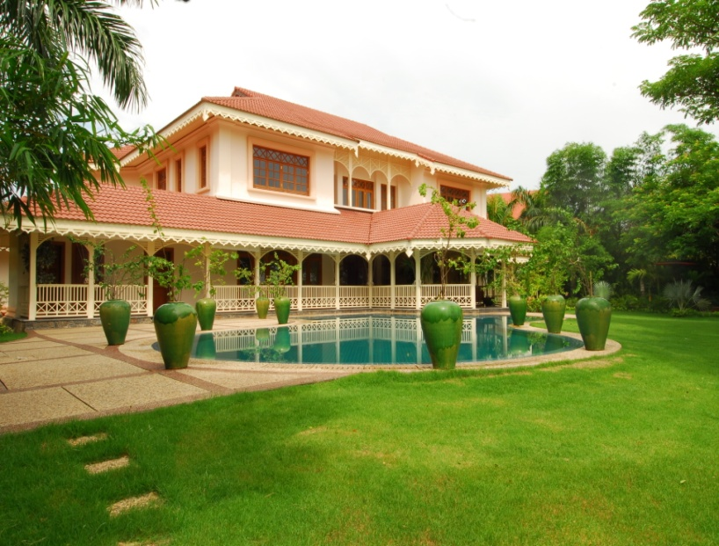
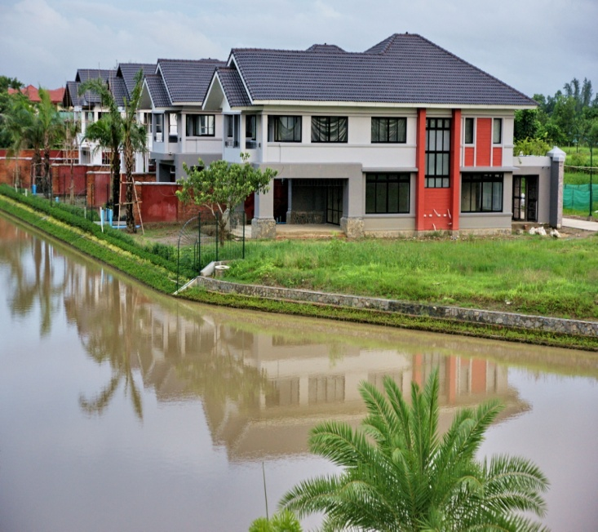
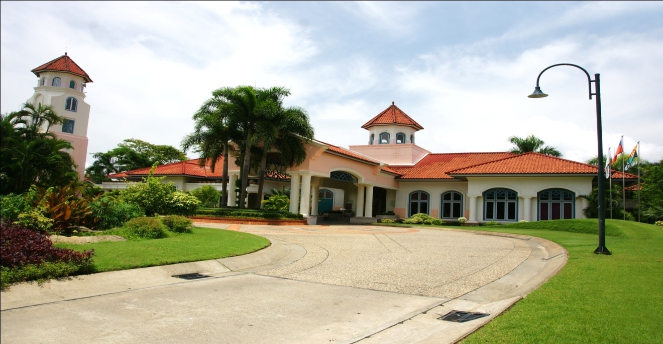
P
U
N
H
L
A
I
N
G
G
O
L
F
E
S
T
A
T
E

Slide 10
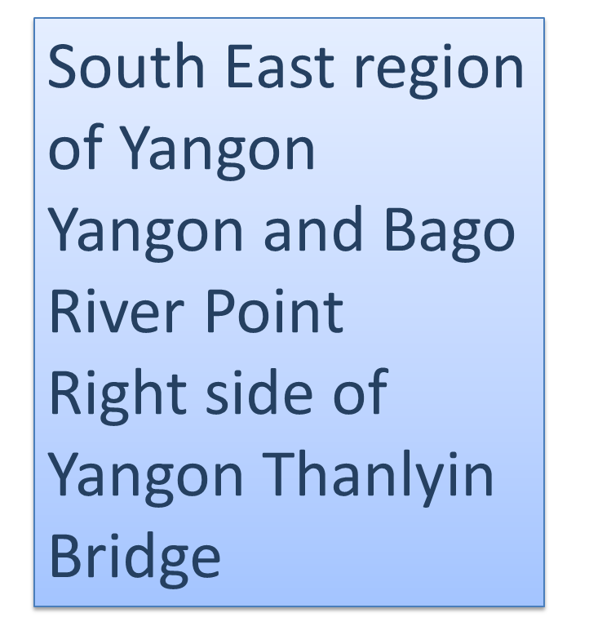
Thanlyin Star City

Slide 11
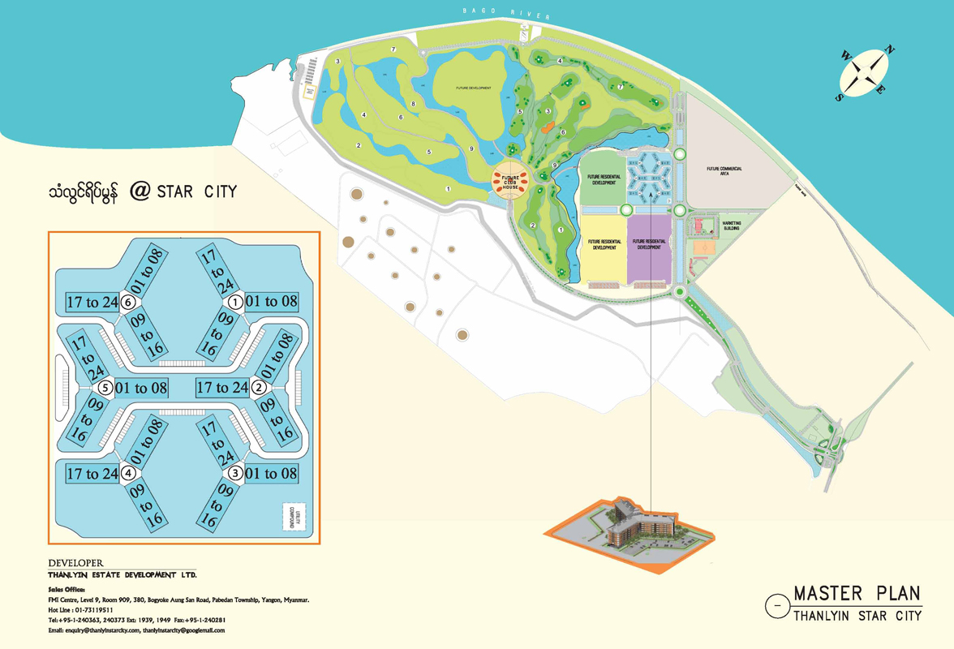

Slide 12
Marketing Building
-Model Apartments
-Sale Gallery
-Master Plan and Building Model`
-Overall Landscapes
surroundings
Promotional Material
-Brochures/ Flyers
-Promotional Video
-In Flight Magazine
-Local Newspaper
Media
-Airport Light box
Display, etc
ACHIEVING SALE TARGET
Master Plan/ Micro Zoning
-Complete Life Style
-Planning Consideration
Site Activities
-Entrance Plaza
-Billboard and Signatures
-Construction Activities

